Slide 1
RestingInPCA

Slide 2
Where we start
The TMS project

Slide 3
Introduction
Recent work in resting-state fMRI (rsfMRI) analysis can derive subject-specific parcellations and sub-networks.
Standard approaches for rsfMRI:
Graph/network analysis
Accommodates different numbers of parcels
Multiple comparisons
Multivariate analysis
Shared template
Groups with larger variance (e.g., elderly, lesion patients, children)

Slide 4
Goals of the project
To analyze resting-state data and allow different participants to have different numbers of regions/network
Keep individual difference
Analyze resting state data in a local, instead of an atlas, space

Slide 5
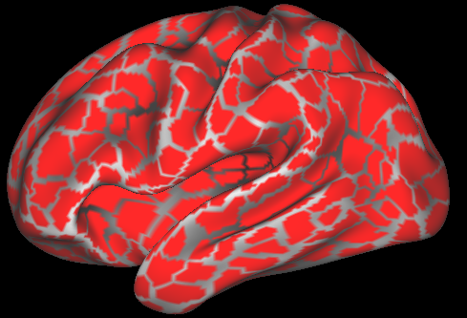
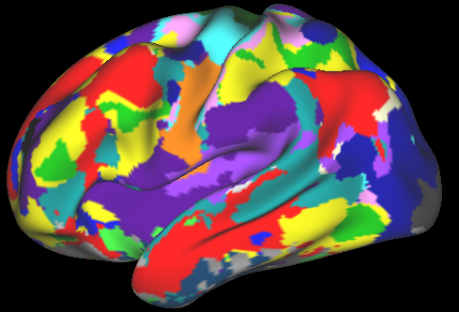
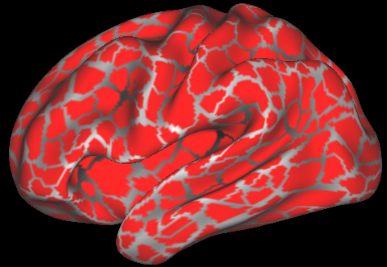
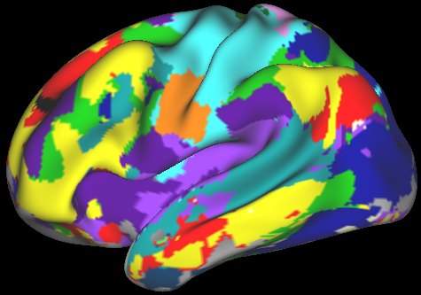
Resting-state data set
Midnight Scan Club (MSC; Gordon et al., 2017)
30-minute resting-state fMRI
10 participants x 10 sessions
Parcellation
Sub-networks
Parcellation
Sub-networks
……
……
MSC01
MSC07

Slide 6
Resting-state data set
Midnight Scan Club (MSC; Gordon et al., 2017)
30-minute resting-state fMRI
10 participants x 10 sessions
Extract time series and create correlation matrix for each session of each subject
Parcellation
Sub-networks
Parcel’s mean time series during resting-state scan
Cross correlation between parcels
Fisher’s Z transformation
MSC01
Frames

Slide 7
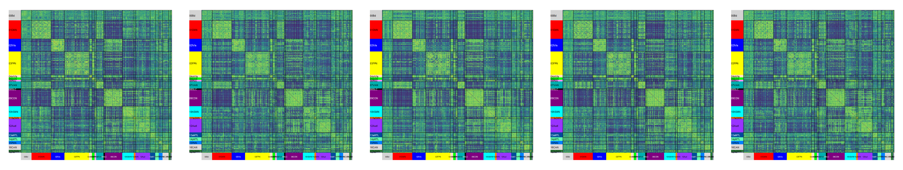
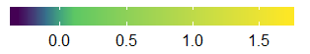
Resting-state data set
MSC01 (Sessions 1-5)
Common Sub-networks
Default
Dorsal Attention
Hand somato-motor
Visual
Ventral attention
Mouth somato-motor
Frontal-parietal control
Cingulo-opercular control
Auditory

Slide 8
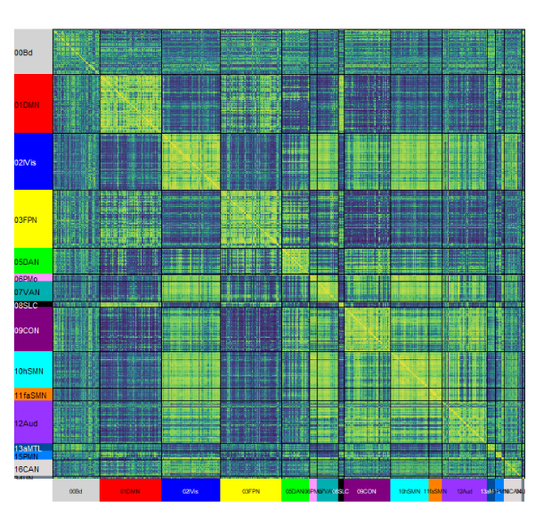
Resting-state data set
For this project:
4 sessions (Sessions 2-5)
Subject-specific parcellation and sub-network
Only include common networks as active elements
All negative correlations are removed
Simulation
Decrease the connectivity by half
within DFN
between DFN - FPN
between DFN - DAN

Slide 9
Solution
Instead of analyzing the correlation matrix, we reshape the upper triangle of this square matrix into a vector and stack the vectors corresponding to different correlation matrix that we want to analyze together
Within DFM
Within AUD
Within
Between
Between DFM-AUD
Between CON-AUD

Slide 10
Solution
Instead of analyzing the correlation matrix, we reshape the upper triangle of this square matrix into a vector and stack the vectors corresponding to different correlation matrix that we want to analyze together
Subj 1
…….
Subj 1
…….

Slide 11
Solution
Instead of analyzing the correlation matrix, we reshape the upper triangle of this square matrix into a vector and stack the vectors corresponding to different correlation matrix that we want to analyze together
Subj 1
Subj 2
…….
Subj 2
…….

Slide 12
Solution
Instead of analyzing the correlation matrix, we reshape the upper triangle of this square matrix into a vector and stack the vectors corresponding to different correlation matrix that we want to analyze together
Subj 1
Subj 2
…...
Subj N
…….
Subj N
…….

Slide 13
Solution
Instead of analyzing the correlation matrix, we reshape the upper triangle of this square matrix into a vector and stack the vectors corresponding to different correlation matrix that we want to analyze together
SVD

Slide 14
Question
What do we to before the SVD?
SVD
?

Slide 15

All possible preprocessing procedures
Double-centering correlation matrices
Centering each vector before stacking them
Normalizing each vector before stacking them
Center the columns
Normalizing the columns (SS =1)
MFA-normalize by subjects
MFA-normalize by edges of networks
Hierarchical MFA-normalize by edges then by subjects
…

Slide 16
All possible preprocessing procedures
Double-centering correlation matrices
Centering each vector before stacking them
Normalizing each vector before stacking them
Center the columns
Normalizing the columns (SS =1)
MFA-normalize by subjects
MFA-normalize by edges of networks
Hierarchical MFA-normalize by edges then by subjects
…

Slide 17
The procedure we picked
Center the columns
MFA-normalize by subjects
HMFA-normalize by edge then by subject

Slide 18
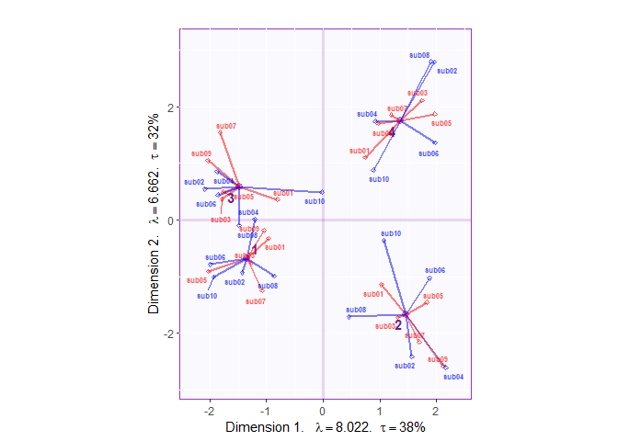
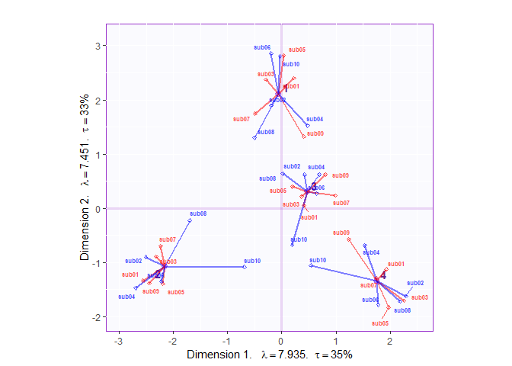
Factor scores (rows)
MFA-normalize by subject
HMFA-normalize by edge then by subject

Slide 19
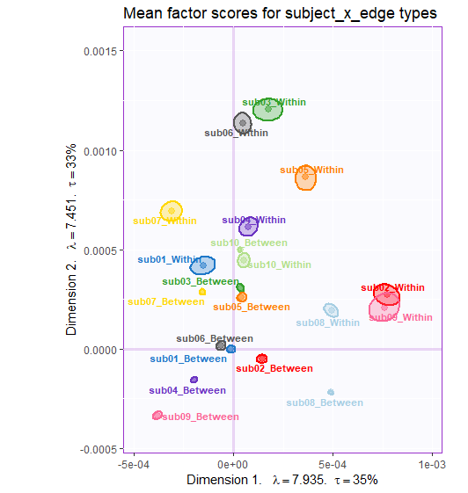
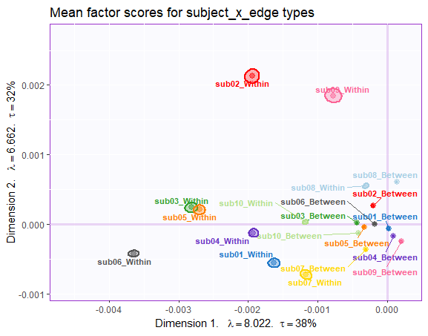
Factor scores (columns)
MFA-normalize by subject
HMFA-normalize by edge then by subject

Slide 20
The procedure we picked
Center the columns
MFA-normalize by subjects
HMFA-normalize by edge then by subject

Slide 21
The procedure we picked
Center the columns
MFA-normalize by subjects
HMFA-normalize by edge then by subject
HMFA-normalize by edge type (within-between) then by subject

Slide 22
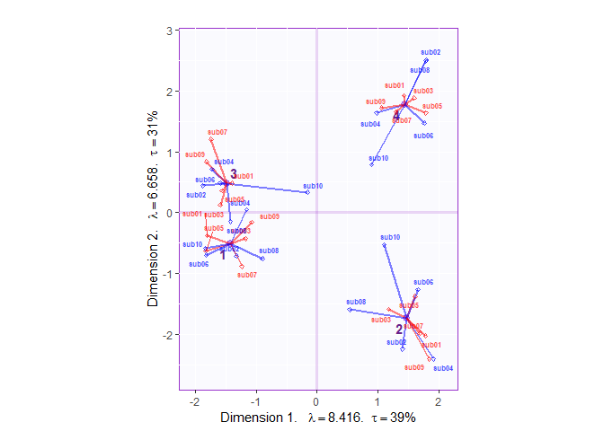
Factor scores (rows)
MFA-normalize by subject
HMFA-normalize by edge type then by subject

Slide 23
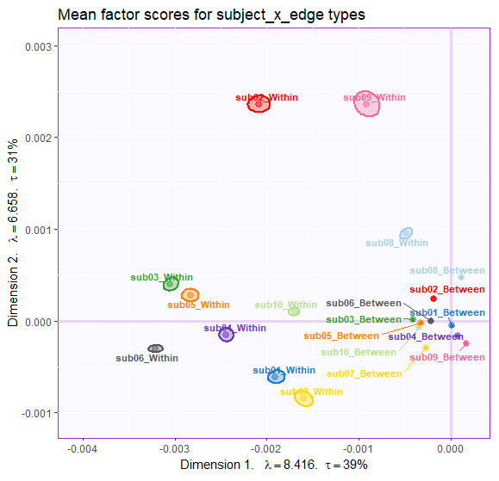
Factor scores (columns)
MFA-normalize by subject
HMFA-normalize by edge type then by subject

Slide 24
Other similar procedure we tried
MFA-normalize by subj x edge types
Normalize each blocks of subj x edge type to SS = 1
HMFA by subject then by edges
HMFA by subject then by edge types
MFA with within-network edges as ACTIVE columns and between-network edges as SUPP columns

Slide 25
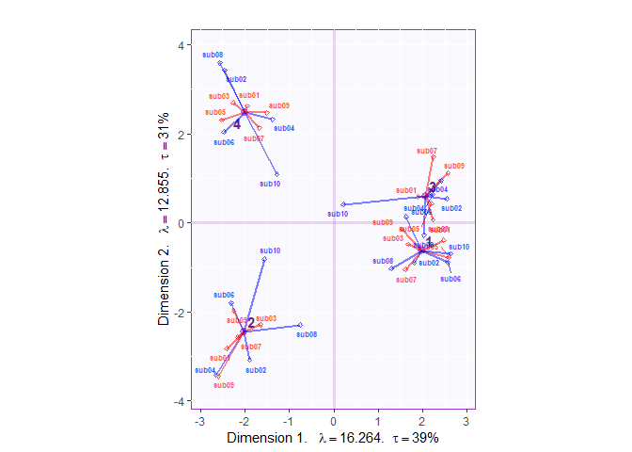
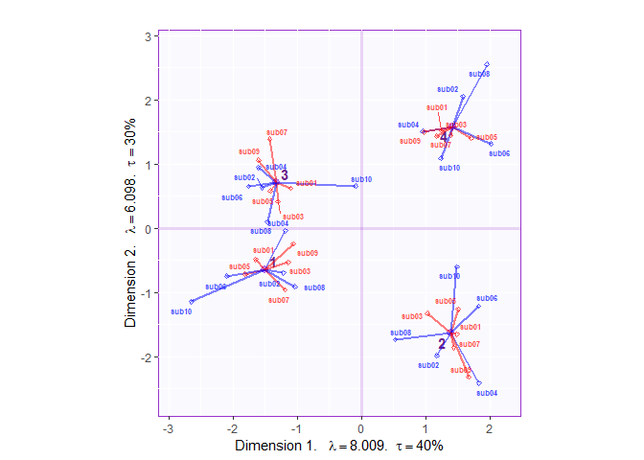
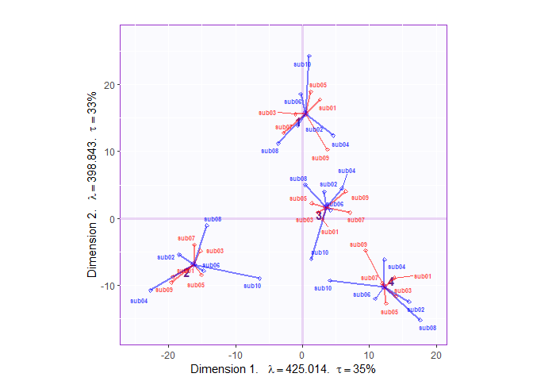
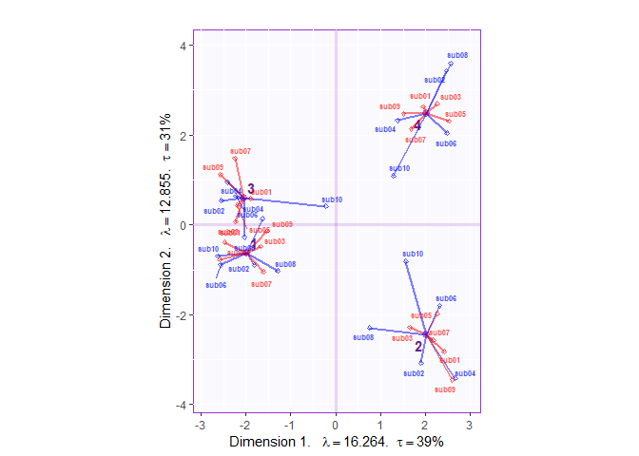
MFA-normalize by subject x edge type
Normalize subject x edge type to SS = 1
HMFA-normalize by subject → edges
HMFA-normalize by subject → edge type

Slide 26
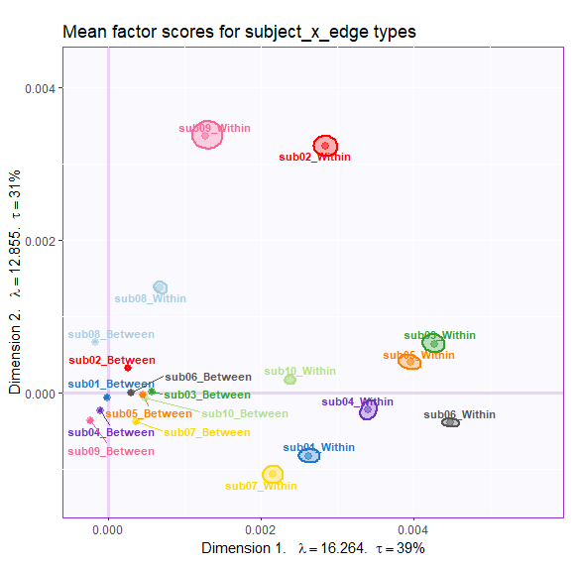
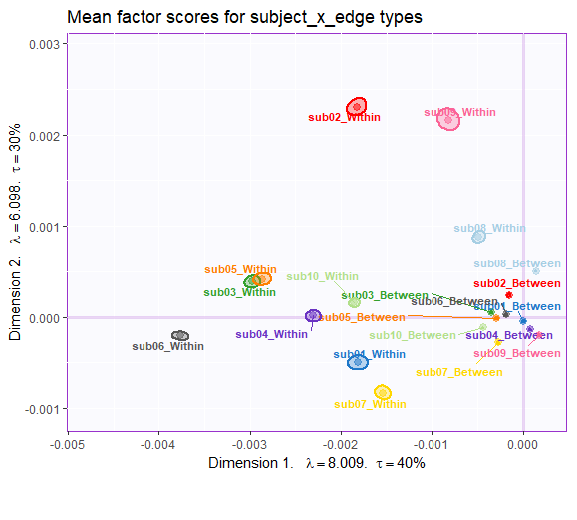
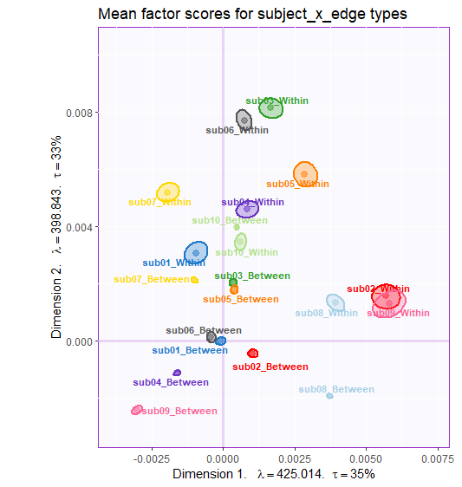

MFA-normalize by subject x edge type
Normalize subject x edge type to SS = 1
HMFA-normalize by subject → edges
HMFA-normalize by subject → edge type

Slide 27
Last hope

Slide 28
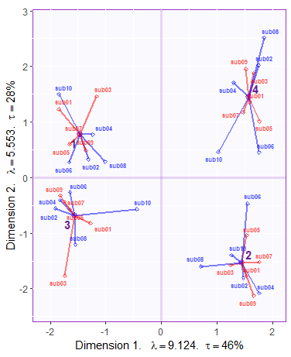
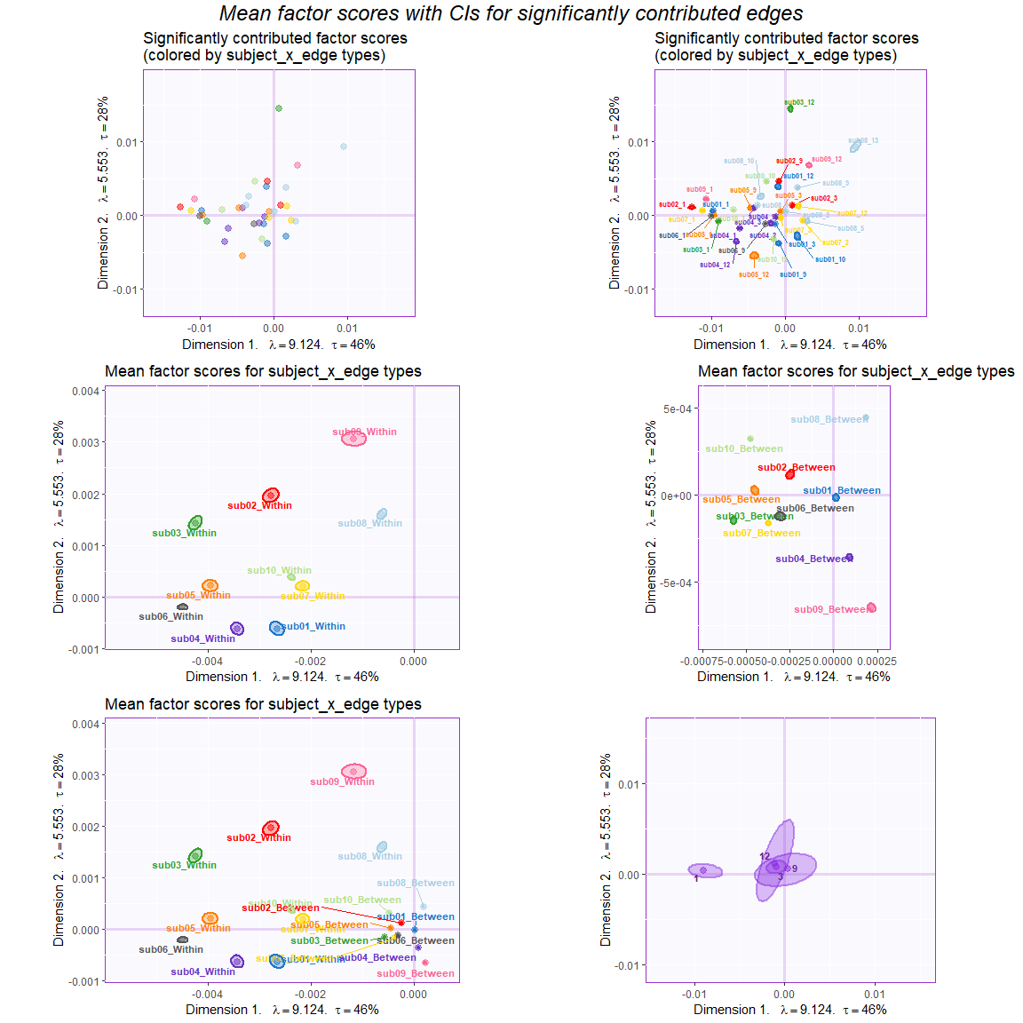
ACTIVE within & SUPP between

Slide 29
ACTIVE within & SUPP between

Slide 30
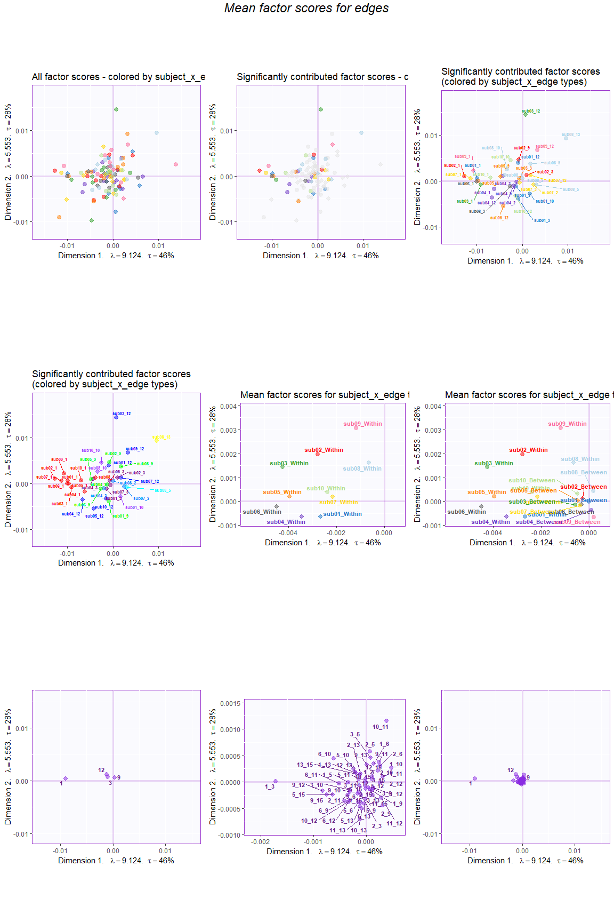
ACTIVE within & SUPP between

Slide 31
ACTIVE within & SUPP between

Slide 32
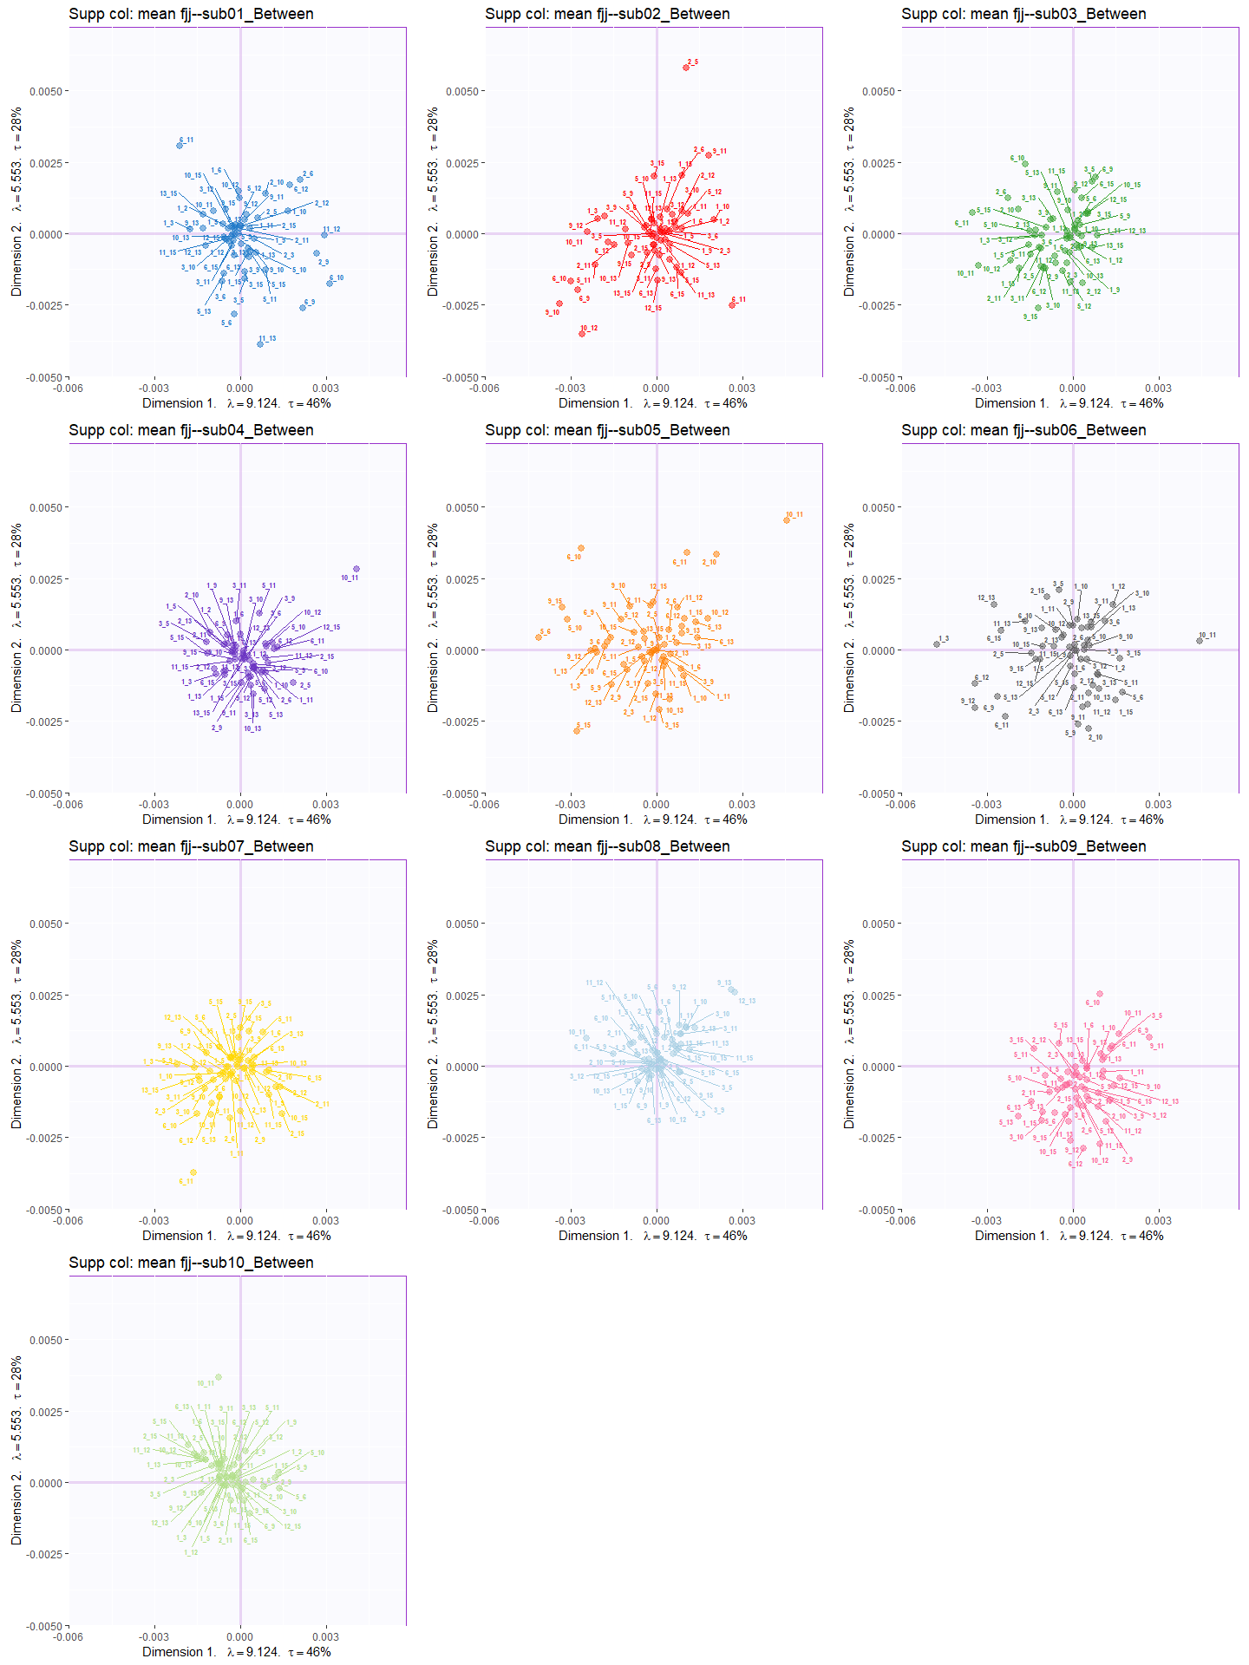
ACTIVE within & SUPP between

Slide 33
Our thoughts
The between-network edges, compared to the within-network ones, are small. (Even smaller with simulations.)
This is why they are very close to the origin.
If normalized by edges, the effects in the small edges will be inflated and the conditions could not be well-differentiated.

